Slide 1


Dimensionality Reduction and Self-Organizing Maps
16
PART IV · LEARNING WITHOUT FULL LABELS
CHAPTER 16 · WEEK 13
Machine Learning — From Hypotheses to Decisions
LECTURER
Dr. Mustafa Hameed
THE ISLAMIA UNIVERSITY OF BAHAWALPUR
Bahawalpur, Pakistan
Department of Information Technology · BSIT · Fall 2026
Notes:
Chapter 16: Dimensionality Reduction and Self-Organizing Maps. Part 4 — Learning Without Full Labels. Week 13: Clustering; PCA and self-organizing maps. Handout pages 118–124.

Slide 2

Where this chapter sits
THE COURSE
PART I
PART II
PART III
PART IV
PART V
PART VI
1
2
3
4
5
6
7
8
9
10
11
12
13
14
15
16
17
18
19
20
21
22
Dimensionality Reduction and Self-Organizing Maps
BUILDS ON
USED LATER IN
Ch 2 Mathematics for Machine Learning
— no later chapter depends on it
Ch 11 Instance-Based Learning: k-Nearest Neighbours
Ch 13 Artificial Neural Networks
Ch 15 Clustering
Machine Learning · Chapter 16 · Dimensionality Reduction and Self-Organizing Maps
Handout p. 118 2
Notes:
Place the chapter. Before you start: Chapter 2 (vectors, variance, matrices), Chapter 11 (the curse of dimensionality), Chapter 15 (centroids and competitive assignment) and Chapter 13 (units, weights and a learning rate: a self-organizing map is a neural network, trained without backpropagation).

Slide 3

What you will be able to do
LEARNING OUTCOMES
By the end of this chapter you will be able to:
1
Explain why reducing the number of features helps, with reference to the curse of dimensionality.
2
Compute principal components by hand for a small two-dimensional dataset, and the variance each explains.
3
Choose how many components to keep, and use PCA inside a pipeline.
4
Describe the self-organizing map, and perform one training step by hand: best-matching unit, neighbourhood and update.
5
Contrast PCA and SOM as ways of seeing high-dimensional data.
Machine Learning · Chapter 16 · Dimensionality Reduction and Self-Organizing Maps
Handout p. 118 3
Notes:
Read these out: they are the chapter's contract with the room. Each click adds one.

Slide 4

Vocabulary for this chapter
KEY TERMS
dimensionality reduction
feature selection vs. extraction
covariance matrix
principal component
eigenvector and eigenvalue
explained variance
scree plot
projection
reconstruction
self-organizing map (Kohonen map)
competitive learning
best-matching unit
neighbourhood function
topology preservation
U-matrix
Each term is defined where it first matters — not here.
Machine Learning · Chapter 16 · Dimensionality Reduction and Self-Organizing Maps
Handout p. 118 4
Notes:
Do not define these now; they arrive one at a time. This slide is for the students' notes. Terms: dimensionality reduction; feature selection vs. extraction; covariance matrix; principal component; eigenvector and eigenvalue; explained variance; scree plot; projection; reconstruction; self-organizing map (Kohonen map); competitive learning; best-matching unit; neighbourhood function; topology preservation; U-matrix.

Slide 5

In this chapter
IN THIS CHAPTER
16.1
Why Fewer Dimensions
p. 118 ›
16.2
Principal Component Analysis
p. 119 ›
16.3
How Many Components?
p. 120 ›
16.4
Self-Organizing Maps
p. 121 ›
Machine Learning · Chapter 16 · Dimensionality Reduction and Self-Organizing Maps
Handout pp. 118–124 5
Notes:
The route through the chapter. Each row is a link: click it to jump to that section in the slide show.

Slide 6

Why Fewer Dimensions
KEY IDEA
Chapter 11 showed what happens when there are too many features: distances concentrate, neighbours stop being meaningful, and every method that relies on distance degrades. High-dimensional data is also slow to process, impossible to look at, and often redundant — the forty metrics a project dashboard records each week (hours, story points, open bugs, test counts, change requests, …) rise and fall together, because a handful of underlying facts about the project drive them all. Two responses exist. Feature selection keeps a subset of the original features (a tree’s splits, lasso’s non-zero weights). Feature extraction builds a smaller set of new features from all the old ones. This chapter covers the two extraction methods in the HEC outline: principal component analysis, which is linear and has an exact solution, and the self-organizing map, a neural network that produces a two-dimensional map.
Machine Learning · Chapter 16 · Dimensionality Reduction and Self-Organizing Maps
§16.1 · Handout p. 118 6
Notes:
Say this in your own words first; the slide is the handout's wording.

Slide 7
Principal Component Analysis
SECTION 2 OF 4
16.2
16.1 Why Fewer Dimensions
16.2 Principal Component Analysis
16.3 How Many Components?
16.4 Self-Organizing Maps
Machine Learning · Chapter 16
Handout §16.2 7
Notes:
Pause. Name the question this section answers.

Slide 8

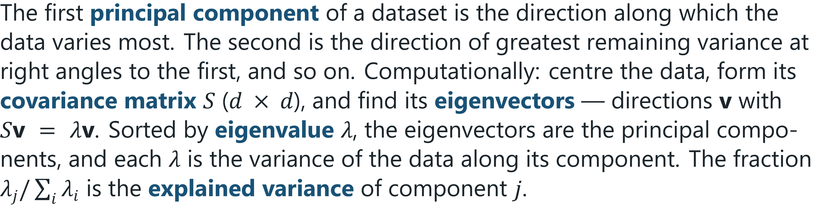
Principal Components
DEFINITION
Machine Learning · Chapter 16 · Dimensionality Reduction and Self-Organizing Maps
§16.2 · Handout p. 119 8
Notes:
Read the box aloud, then ask for an example from the room before moving on.

Slide 9

PCA by Hand in Two Dimensions
WORKED EXAMPLE
Five examples: (1, 2), (2, 1), (3, 3), (4, 5), (5, 4).
Centre. The mean is (3, 3); centred data: (−2, −1), (−1, −2), (0, 0), (1, 2), (2, 1).
Covariance (dividing by n − 1 = 4):
Eigenvectors. For this symmetric pattern they are (1, 1)/√2 and (1, −1)/√2. Check: S(1,1) = (4.5, 4.5) = 4.5 (1,1), and S(1,−1) = (0.5, −0.5) = 0.5 (1,−1). So λ₁ = 4.5, λ₂ = 0.5.
Explained variance: PC1 carries 4.5/5 = 90%, PC2 the remaining 10%.
Machine Learning · Chapter 16 · Dimensionality Reduction and Self-Organizing Maps
§16.2 · Handout p. 119 9
Notes:
Keeping the first m components and projecting each example onto them — zj = vj · (x − x̄) — replaces d features by m while losing as little variance as any linear projection can. Equivalently, it is the projection with the smallest reconstruction error: mapping the m scores back into the original space loses the least.
Each click adds one step of the working. Ask for the next number before you reveal it.

Slide 10
PCA by Hand in Two Dimensions (continued)
WORKED EXAMPLE
Scores on PC1: z = (x₁ + x₂)/√2 for each centred point: −2.12, −2.12, 0, 2.12, 2.12.
One number per example now keeps 90% of the variation. The discarded direction, x₁ − x₂, only records which of the two coordinates is slightly larger — if that is noise, PCA has removed it.
Machine Learning · Chapter 16 · Dimensionality Reduction and Self-Organizing Maps
§16.2 · Handout p. 119 10
Notes:
Each click adds one step of the working. Ask for the next number before you reveal it.

Slide 11
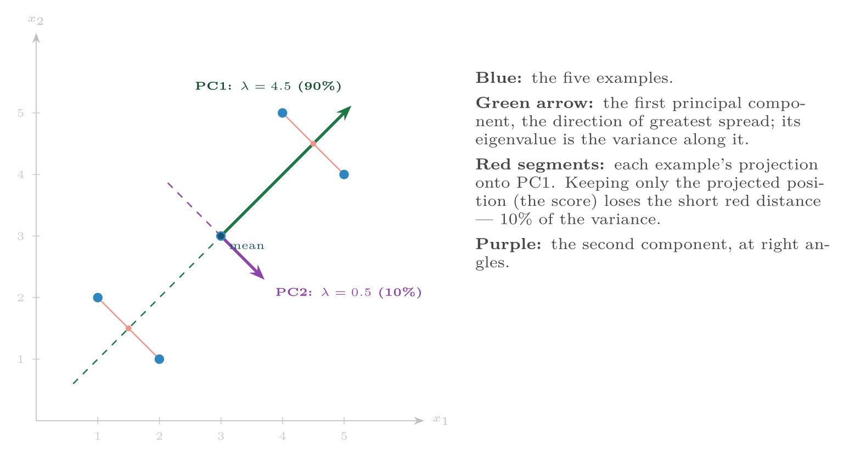
The worked example
FIGURE 16.1
PCA rotates the axes to line up with the directions of greatest variance; dropping PC2 projects every point onto the green line.
Machine Learning · Chapter 16 · Dimensionality Reduction and Self-Organizing Maps
§16.2 · Handout p. 119 11
Notes:
Figure 16.1 (handout p. 120): The worked example. PCA rotates the axes to line up with the directions of greatest variance; dropping PC2 projects every point onto the green line.

Slide 12
How Many Components?
SECTION 3 OF 4
16.3
16.1 Why Fewer Dimensions
16.2 Principal Component Analysis
16.3 How Many Components?
16.4 Self-Organizing Maps
Machine Learning · Chapter 16
Handout §16.3 12
Notes:
Pause. Name the question this section answers.

Slide 13
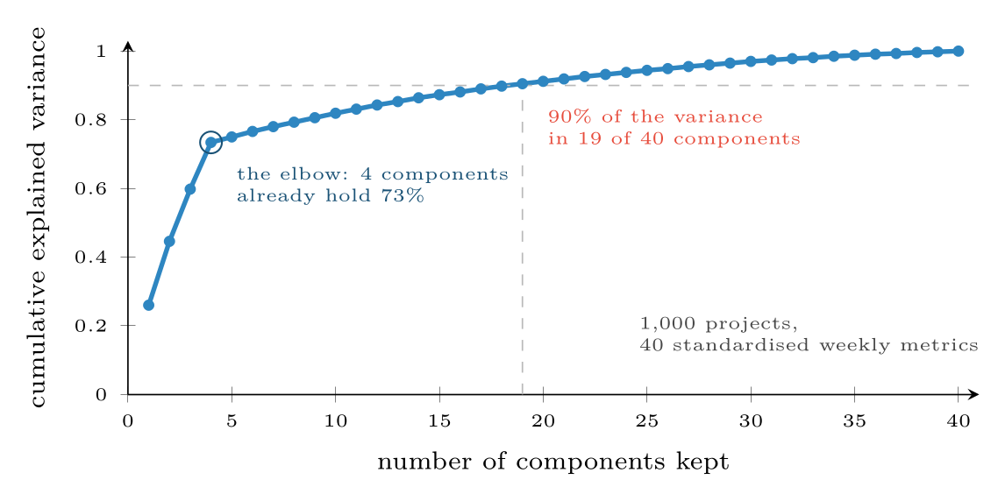
Cumulative explained variance for forty weekly project metrics
FIGURE 16.2
The curve rises steeply for four components and then flattens: four underlying factors drive almost everything the dashboard shows, and the rest is noise.
Machine Learning · Chapter 16 · Dimensionality Reduction and Self-Organizing Maps
§16.3 · Handout p. 120 13
Notes:
Figure 16.2 (handout p. 120): Cumulative explained variance for forty weekly project metrics. The curve rises steeply for four components and then flattens: four underlying factors drive almost everything the dashboard shows, and the rest is noise.

Slide 14

Standardise First, and Remember What PCA Ignores
WATCH OUT
PCA finds directions of large variance, so a feature measured in large units dominates the first component purely because of its units. Standardise first, unless the features share a scale that means something. And PCA is unsupervised: the direction of greatest variance need not be the direction that separates the classes. A small, discarded component can be the one that matters.
Machine Learning · Chapter 16 · Dimensionality Reduction and Self-Organizing Maps
§16.3 · Handout p. 120 14
Notes:
Three rules are in use: keep enough components to explain a target fraction of the variance (90% or 95% are common); keep the components before the elbow of the eigenvalue plot (the scree plot); or — when PCA is a step before a supervised model — treat the number of components as a hyperparameter and choose it by cross-validation. On the project metrics of this chapter’s lab, logistic regression predicting which projects finish late scores 54% on one component, 63% on two, 89% on four, and slightly less on ten (88%) or all forty (88%): the four components before the elbow carry everything that matters, and the rest only adds noise. The 90% rule would have kept nineteen.

Slide 15
Self-Organizing Maps
SECTION 4 OF 4
16.4
16.1 Why Fewer Dimensions
16.2 Principal Component Analysis
16.3 How Many Components?
16.4 Self-Organizing Maps
Machine Learning · Chapter 16
Handout §16.4 15
Notes:
Pause. Name the question this section answers.

Slide 16
Self-Organizing Map
DEFINITION
A grid of units (often 10 × 10), each holding a weight vector w_{u} of the same dimension as the data. Training repeats, for randomly chosen examples x:
1. Compete: find the best-matching unit (BMU), the unit whose weight vector is closest to x.
2. Cooperate: every unit u gets a neighbourhood weight h(u), 1 at the BMU and falling with distance on the grid — usually h(u) = exp(−grid distance² / 2σ²).
3. Adapt: move every unit towards the example: w_{u} ← w_{u} + η h(u) (x − w_{u}).
Both the learning rate η and the neighbourhood width σ shrink during training: first the map organises roughly, then each unit fine-tunes.
Machine Learning · Chapter 16 · Dimensionality Reduction and Self-Organizing Maps
§16.4 · Handout p. 121 16
Notes:
A self-organizing map (SOM, or Kohonen map, after Teuvo Kohonen) is a neural network that learns to lay high-dimensional data out on a two-dimensional grid, so that similar examples land on nearby grid cells. It is unsupervised, and its output is a picture: a map of the data that people can read.

Slide 17
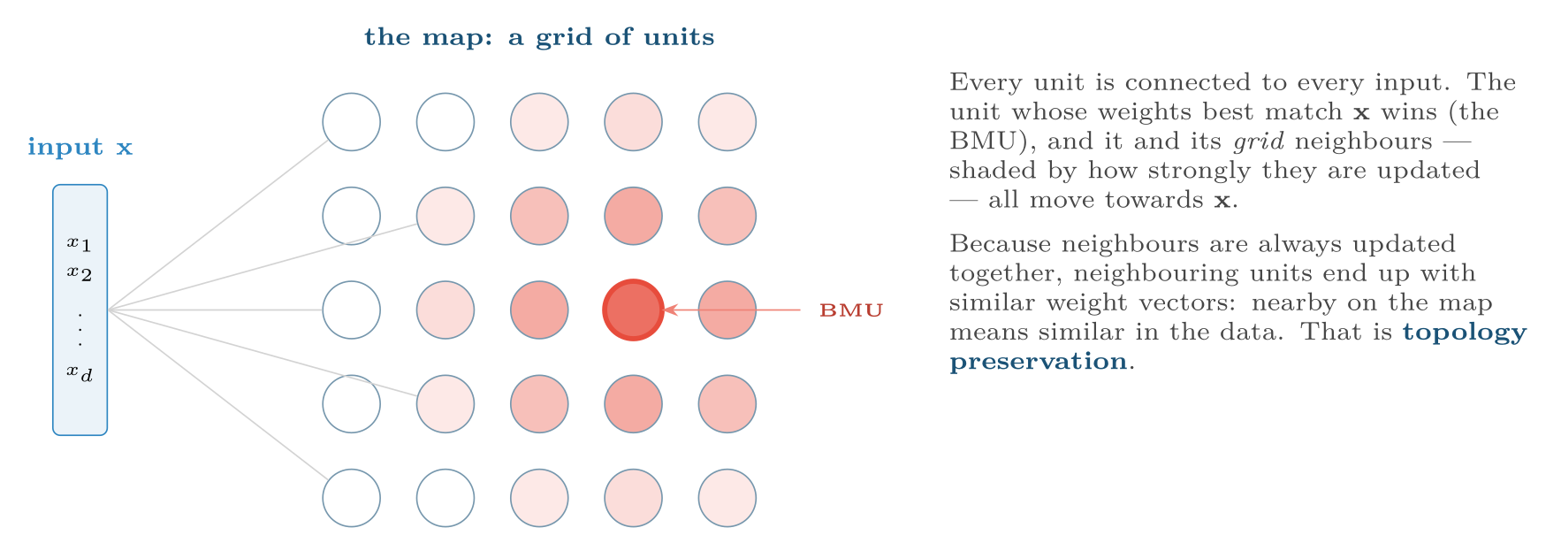
A self-organizing map
FIGURE 16.3
Competition picks one winner; cooperation spreads the update over its neighbourhood on the grid, which is what makes the map smooth.
Machine Learning · Chapter 16 · Dimensionality Reduction and Self-Organizing Maps
§16.4 · Handout p. 121 17
Notes:
Figure 16.3 (handout p. 121): A self-organizing map. Competition picks one winner; cooperation spreads the update over its neighbourhood on the grid, which is what makes the map smooth.

Slide 18
One SOM Update
WORKED EXAMPLE
A one-dimensional map of three units with two-dimensional weights: w₁ = (0.2, 0.8), w₂ = (0.5, 0.5), w₃ = (0.9, 0.1). Input x = (0.8, 0.3); learning rate η = 0.5; neighbourhood h = 1 for the BMU, 0.5 for its immediate neighbours, 0 beyond.
Compete. Distances: ‖x − w₁‖ = √(0.6² + 0.5²) = 0.781; ‖x − w₂‖ = √(0.3² + 0.2²) = 0.361; ‖x − w₃‖ = √(0.1² + 0.2²) = 0.224. BMU: unit 3.
Adapt.
• Unit 3 (h = 1): w₃ + 0.5 × 1 × ((0.8, 0.3) − (0.9, 0.1)) = (0.9, 0.1) + (−0.05, 0.10) = (0.85, 0.20).
• Unit 2 (h = 0.5, the BMU’s neighbour): (0.5, 0.5) + 0.25 × (0.3, −0.2) = (0.575, 0.45).
• Unit 1 (h = 0, two steps away on the map): unchanged.
Unit 2 moved towards x although it did not win — that is the cooperation. After many such steps, unit 3 represents inputs like x, and unit 2 inputs somewhere between unit 1’s and unit 3’s.
Machine Learning · Chapter 16 · Dimensionality Reduction and Self-Organizing Maps
§16.4 · Handout p. 121 18
Notes:
Each click adds one step of the working. Ask for the next number before you reveal it.

Slide 19

Reading a Trained Map
CONCEPT
Each unit becomes a prototype for the examples that map to it, so a SOM is also a clustering (and with σ → 0 it is exactly on-line k-means). Colour each unit by the class of the examples it attracts and the classes appear as regions — the lab’s six-by-six map of past projects puts maintenance work in one corner and the two similar kinds, new builds and integrations, next to each other elsewhere. The U-matrix colours each unit by the average distance to its neighbours’ weights: high values mark the borders between groups, so cluster boundaries become visible walls on the map.
Machine Learning · Chapter 16 · Dimensionality Reduction and Self-Organizing Maps
§16.4 · Handout p. 121 19
Notes:
Read the box aloud, then ask for an example from the room before moving on.

Slide 20

Self-Organizing Maps
AT A GLANCE
 | PCA | Self-organizing map
Mapping | Linear projection | Non-linear; follows curved structure
Solution | Exact, unique (eigenvectors) | Iterative; depends on initialisation and schedule
Output | m new numeric features | A position on a 2-D grid, plus prototypes
Best for | Compression, pre-processing, removing correlation | Visual exploration, clustering, prototype-based summaries
New examples | Project with the same components | Map to the BMU
Machine Learning · Chapter 16 · Dimensionality Reduction and Self-Organizing Maps
§16.4 · Handout p. 121 20
Notes:
Do not read the table row by row: pick the row the room is most likely to get wrong and ask why.

Slide 21

Common pitfalls
COMMON PITFALLS
✕
Running PCA on unscaled features. The component is then decided by units.
✕
Fitting PCA on all the data before splitting. It is a fitted transformer: put it in the pipeline (Chapter 3).
✕
Assuming high variance means high relevance. PCA does not look at the labels.
✕
Interpreting components as causes. A component is a weighted mix of every feature; naming it takes care.
✕
Keeping the SOM neighbourhood wide to the end. The map never fine-tunes; shrink σ and η over training.
Machine Learning · Chapter 16 · Dimensionality Reduction and Self-Organizing Maps
§16.4 · Handout p. 121 21
Notes:
For each pitfall, ask who has seen it happen. One real story beats five bullets.

Slide 22

Try it yourself: PCA by Hand, PCA at Work, and a Map of Past Projects
TRY IT YOURSELF
Part 2 makes 1,000 projects whose forty weekly metrics are driven by four hidden factors (size, quality, churn, staffing) plus noise, and asks which finish late. Part 3 maps 150 projects of three kinds: maintenance, new builds and integrations, each described by four standardised features.
WHAT YOU WILL DO
1. The worked example: PCA by eigen-decomposition
2. 40 dashboard metrics: how many components?
3. A self-organizing map in twenty lines
THIS WEEK'S LAB
WHAT YOU WILL RUN
RUNNABLE COPY
Week 13: k-means and a dendrogram; PCA and a SOM
1 listing, 66 lines of Python
code/ch16_pca_hand_pca_work_map.py
Machine Learning · Chapter 16 · Dimensionality Reduction and Self-Organizing Maps
§16.4 · Handout p. 121 22
Notes:
Part 2 makes 1,000 projects whose forty weekly metrics are driven by four hidden factors (size, quality, churn, staffing) plus noise, and asks which finish late. Part 3 maps 150 projects of three kinds: maintenance, new builds and integrations, each described by four standardised features.

Slide 23
PCA by Hand, PCA at Work, and a Map of Past Projects
LAB · STEP 1 OF 5
Set-up
Python · code/ch16_pca_hand_pca_work_map.py
2
3
4
5
6
7
import numpy as np
from sklearn.decomposition import PCA
from sklearn.pipeline import make_pipeline
from sklearn.preprocessing import StandardScaler
from sklearn.linear_model import LogisticRegression
from sklearn.model_selection import cross_val_score
Machine Learning · Chapter 16 · Dimensionality Reduction and Self-Organizing Maps
§16.4 · Handout p. 121 23
Notes:
Step 1: Set-up. Read the code aloud; ask what each line would print before running it.

Slide 24
PCA by Hand, PCA at Work, and a Map of Past Projects
LAB · STEP 2 OF 5
The worked example: PCA by eigen-decomposition
Python · code/ch16_pca_hand_pca_work_map.py
9
10
11
12
13
14
15
16
17
18
19
# --- 1. the worked example: PCA by eigen-decomposition -------------------
X = np.array([[1, 2], [2, 1], [3, 3], [4, 5], [5, 4]], dtype=float)
Xc = X - X.mean(axis=0) # centre
S = np.cov(Xc, rowvar=False) # covariance, divides by n - 1
vals, vecs = np.linalg.eigh(S) # eigenvalues, ascending
order = np.argsort(vals)[::-1]
vals, vecs = vals[order], vecs[:, order]
print("covariance:\n", S)
print("eigenvalues:", vals, " explained:", (vals / vals.sum()).round(3))
print("PC1 direction:", vecs[:, 0].round(3))
print("scores on PC1:", (Xc @ vecs[:, 0]).round(3))
Machine Learning · Chapter 16 · Dimensionality Reduction and Self-Organizing Maps
§16.4 · Handout p. 121 24
Notes:
Step 2: The worked example: PCA by eigen-decomposition. Read the code aloud; ask what each line would print before running it.

Slide 25
PCA by Hand, PCA at Work, and a Map of Past Projects
LAB · STEP 3 OF 5
40 dashboard metrics: how many components?
Python · code/ch16_pca_hand_pca_work_map.py
21
22
23
24
25
26
27
28
29
30
31
32
33
34
35
36
# --- 2. 40 dashboard metrics: how many components? -----------------------
rng = np.random.default_rng(16)
n, d = 1000, 40 # projects, weekly metrics
Z = rng.normal(size=(n, 4)) # hidden: size, quality, churn, staff
A = rng.normal(size=(4, d)) # how each metric reflects them
Xm = Z @ A + rng.normal(0, 1.0, (n, d)) # what the dashboard records
ym = (Z[:, 0] - Z[:, 1] + 0.5 * Z[:, 2] + rng.normal(0, 0.5, n) > 0) # late
pca = PCA().fit(StandardScaler().fit_transform(Xm))
cum = np.cumsum(pca.explained_variance_ratio_)
for target in (0.5, 0.8, 0.9, 0.95):
print(f"{target:.0%} of variance needs {np.argmax(cum >= target) + 1} "
f"of {d} components")
for k in (1, 2, 4, 10, 40):
pipe = make_pipeline(StandardScaler(), PCA(k), LogisticRegression())
acc = cross_val_score(pipe, Xm, ym, cv=5).mean()
print(f"logistic regression on {k:2d} components: accuracy {acc:.3f}")
Machine Learning · Chapter 16 · Dimensionality Reduction and Self-Organizing Maps
§16.4 · Handout p. 121 25
Notes:
Step 3: 40 dashboard metrics: how many components?. Read the code aloud; ask what each line would print before running it.

Slide 26
PCA by Hand, PCA at Work, and a Map of Past Projects
LAB · STEP 4 OF 5
A self-organizing map in twenty lines
Python · code/ch16_pca_hand_pca_work_map.py
38
39
40
41
42
43
44
45
46
47
48
49
50
# --- 3. a self-organizing map in twenty lines ----------------------------
rng = np.random.default_rng(16)
kinds = np.repeat([0, 1, 2], 50) # maintenance, build, integration
centre = np.array([[-1.5, -1.2, -1.5, -0.5], # small, short, little new
[0.8, 0.9, 1.2, 0.2], # new build
[0.8, 0.6, 0.3, 1.0]]) # many integrations
Xi = centre[kinds] + rng.normal(0, 0.45, (150, 4))
Xi = StandardScaler().fit_transform(Xi)
rows, cols = 6, 6
grid = np.array([(r, c) for r in range(rows) for c in range(cols)])
rng = np.random.default_rng(0)
W = rng.normal(0, 0.5, (rows * cols, Xi.shape[1]))
steps = 3000
Machine Learning · Chapter 16 · Dimensionality Reduction and Self-Organizing Maps
§16.4 · Handout p. 121 26
Notes:
Step 4: A self-organizing map in twenty lines. Read the code aloud; ask what each line would print before running it.

Slide 27
PCA by Hand, PCA at Work, and a Map of Past Projects
LAB · STEP 5 OF 5
A self-organizing map in twenty lines (continued)
Python · code/ch16_pca_hand_pca_work_map.py
51
52
53
54
55
56
57
58
59
60
61
62
63
64
65
66
67
for t in range(steps):
x = Xi[rng.integers(len(Xi))]
bmu = np.argmin(((W - x) ** 2).sum(axis=1)) # best-matching unit
eta = 0.5 * (1 - t / steps) # learning rate decays
sigma = 3.0 * (1 - t / steps) + 0.5 # neighbourhood shrinks
d2 = ((grid - grid[bmu]) ** 2).sum(axis=1) # distance on the map
h = np.exp(-d2 / (2 * sigma ** 2)) # neighbourhood weight
W += eta * h[:, None] * (x - W)
# label each unit with the kind of project that most often maps to it
hits = {}
for x, y in zip(Xi, kinds):
u = np.argmin(((W - x) ** 2).sum(axis=1))
hits.setdefault(u, []).append(y)
names = "mbi" # maintenance, build, integration
for r in range(rows):
print(" ".join(names[np.bincount(hits[r * cols + c]).argmax()]
if r * cols + c in hits else "." for c in range(cols)))
Machine Learning · Chapter 16 · Dimensionality Reduction and Self-Organizing Maps
§16.4 · Handout p. 121 27
Notes:
Step 5: A self-organizing map in twenty lines (continued). Read the code aloud; ask what each line would print before running it.

Slide 28
What the lab shows
TRY IT YOURSELF
The last block prints the map: m, b and i mark units that maintenance, new-build and integration projects map to, and . an unused unit. Rerun it with sigma = 0.5 throughout (no shrinking neighbourhood): is the map still organised?
Machine Learning · Chapter 16 · Dimensionality Reduction and Self-Organizing Maps
§16.4 · Handout p. 121 28
Notes:
Read the box aloud, then ask for an example from the room before moving on.

Slide 29

A covariance matrix has eigenvalues 6, 3 and 1. What fraction of the variance do the first two components explain?
CHECKPOINT 1 OF 3
Discuss with the person next to you, then advance.
Machine Learning · Chapter 16 · Dimensionality Reduction and Self-Organizing Maps
Handout p. 124 · answers in Appendix D 29
Notes:
Ask the room. Do not advance until someone commits to an answer.

Slide 30

A covariance matrix has eigenvalues 6, 3 and 1. What fraction of the variance do the first two components explain?
CHECKPOINT 1 OF 3 · ANSWER
(6 + 3)/(6 + 3 + 1) = 0.9.
Machine Learning · Chapter 16 · Dimensionality Reduction and Self-Organizing Maps
Handout p. 124 · answers in Appendix D 30
Notes:
Answer (Appendix D): (6 + 3)/(6 + 3 + 1) = 0.9.

Slide 31
Why must features usually be standardised before PCA?
CHECKPOINT 2 OF 3
Discuss with the person next to you, then advance.
Machine Learning · Chapter 16 · Dimensionality Reduction and Self-Organizing Maps
Handout p. 124 · answers in Appendix D 31
Notes:
Ask the room. Do not advance until someone commits to an answer.

Slide 32
Why must features usually be standardised before PCA?
CHECKPOINT 2 OF 3 · ANSWER
PCA seeks directions of large variance, and a feature measured in large units has large variance whether or not it is informative; it would dominate the components purely because of its units.
Machine Learning · Chapter 16 · Dimensionality Reduction and Self-Organizing Maps
Handout p. 124 · answers in Appendix D 32
Notes:
Answer (Appendix D): PCA seeks directions of large variance, and a feature measured in large units has large variance whether or not it is informative; it would dominate the components purely because of its units.

Slide 33
In a SOM, what is the difference between the best-matching unit and its neighbourhood, and why are both updated?
CHECKPOINT 3 OF 3
Discuss with the person next to you, then advance.
Machine Learning · Chapter 16 · Dimensionality Reduction and Self-Organizing Maps
Handout p. 124 · answers in Appendix D 33
Notes:
Ask the room. Do not advance until someone commits to an answer.

Slide 34
In a SOM, what is the difference between the best-matching unit and its neighbourhood, and why are both updated?
CHECKPOINT 3 OF 3 · ANSWER
The BMU is the single unit whose weights are closest to the input (competition). Its neighbourhood is the units near it on the grid. Updating the neighbours as well makes adjacent units similar, which produces a smooth, topology-preserving map.
Machine Learning · Chapter 16 · Dimensionality Reduction and Self-Organizing Maps
Handout p. 124 · answers in Appendix D 34
Notes:
Answer (Appendix D): The BMU is the single unit whose weights are closest to the input (competition). Its neighbourhood is the units near it on the grid. Updating the neighbours as well makes adjacent units similar, which produces a smooth, topology-preserving map.

Slide 35

What to take away
CHAPTER SUMMARY
1
Reducing dimensions fights the curse of dimensionality, removes redundancy and makes data visible; selection keeps features, extraction builds new ones.
2
PCA’s components are the eigenvectors of the covariance matrix; each eigenvalue is the variance along its component. Keep enough to explain a target fraction, or tune the number by cross-validation.
3
Standardise before PCA, fit it inside the pipeline, and remember it ignores the labels.
4
A SOM finds the best-matching unit for each input and moves it and its grid neighbours towards the input; with a shrinking neighbourhood it produces a smooth, topology-preserving 2-D map.
5
PCA is linear, exact and for compression; the SOM is non-linear, iterative and for visual exploration.
Machine Learning · Chapter 16 · Dimensionality Reduction and Self-Organizing Maps
Handout p. 124 35
Notes:
Ask the room to say each takeaway before you reveal it.

Slide 36

Quick check 1 of 3
REVIEW · MULTIPLE CHOICE
The first principal component is the direction of:
A
greatest class separation
B
greatest variance
C
smallest variance
D
the first feature
Machine Learning · Chapter 16 · Dimensionality Reduction and Self-Organizing Maps
Handout p. 124 36
Notes:
Take a show of hands for each option before discussing. (The handout does not print MCQ answers.)

Slide 37
Quick check 2 of 3
REVIEW · MULTIPLE CHOICE
In a SOM, the neighbourhood function is measured by distance:
A
in the input space
B
on the grid of units
C
between classes
D
between eigenvalues
Machine Learning · Chapter 16 · Dimensionality Reduction and Self-Organizing Maps
Handout p. 124 37
Notes:
Take a show of hands for each option before discussing. (The handout does not print MCQ answers.)

Slide 38
Quick check 3 of 3
REVIEW · MULTIPLE CHOICE
Principal components are:
A
correlated
B
at right angles to each other
C
always three in number
D
the original features
Machine Learning · Chapter 16 · Dimensionality Reduction and Self-Organizing Maps
Handout p. 124 38
Notes:
Take a show of hands for each option before discussing. (The handout does not print MCQ answers.)

Slide 39
For your notebook
REVIEW QUESTIONS
SHORT
Explain the difference between feature selection and feature extraction, with one method of each.
SHORT
Why might a discarded low-variance component matter for classification?
SHORT
What does a U-matrix show?
APPLIED
For the points (1, 3), (3, 1), (4, 4), (5, 7) and (7, 5), compute the covariance matrix, verify that (1, 1) is an eigenvector, and find the fraction of the variance the first principal component explains.
APPLIED
Continue the SOM worked example with the next input (0.3, 0.7), using the updated weights. Which unit wins, and what are the three weight vectors afterwards?
Machine Learning · Chapter 16 · Dimensionality Reduction and Self-Organizing Maps
Handout p. 124 39
Notes:
Set these for independent study. Model answers are not printed in the handout.

Slide 40
End of Chapter 16
16
NEXT
READ
Chapter 17 — Semi-Supervised Learning and the EM Algorithm
Handout Chapter 16, pages 118–124
THIS WEEK'S LAB
ASSESSMENT
k-means and a dendrogram; PCA and a SOM
Quiz 3 (Ch 9–14)
Machine Learning · Chapter 16 · Dimensionality Reduction and Self-Organizing Maps
40
Notes:
Close. NEXT: Chapter 17 — Semi-Supervised Learning and the EM Algorithm. READ: Handout Chapter 16, pages 118–124. THIS WEEK'S LAB: k-means and a dendrogram; PCA and a SOM. ASSESSMENT: Quiz 3 (Ch 9–14).

